Slide 1

University of Akron
AirPortal & Concur Training
Notes:
Main Headline: Open Sans Light, size 54 pt, white
Sub Headline: Adjectives or descriptors in Open Sans Bold/Nouns or Verbs in Open Sans Light, size 27, white

Slide 2

University of Akron travel
The University of Akron is partnering with Christopherson Business Travel to manage travel that is paid for by The University of Akron.
IUC – Inter University Council of Ohio preferred travel management company.
As of May 15, 2023, travel should be booked with Christopherson Business Travel.
Previous travel and credits to be managed with the airlines directly.
Current p-cards are still available to book travel. New travel cards are going to be distributed June 7th.

Slide 3
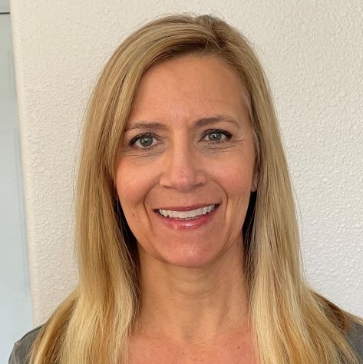
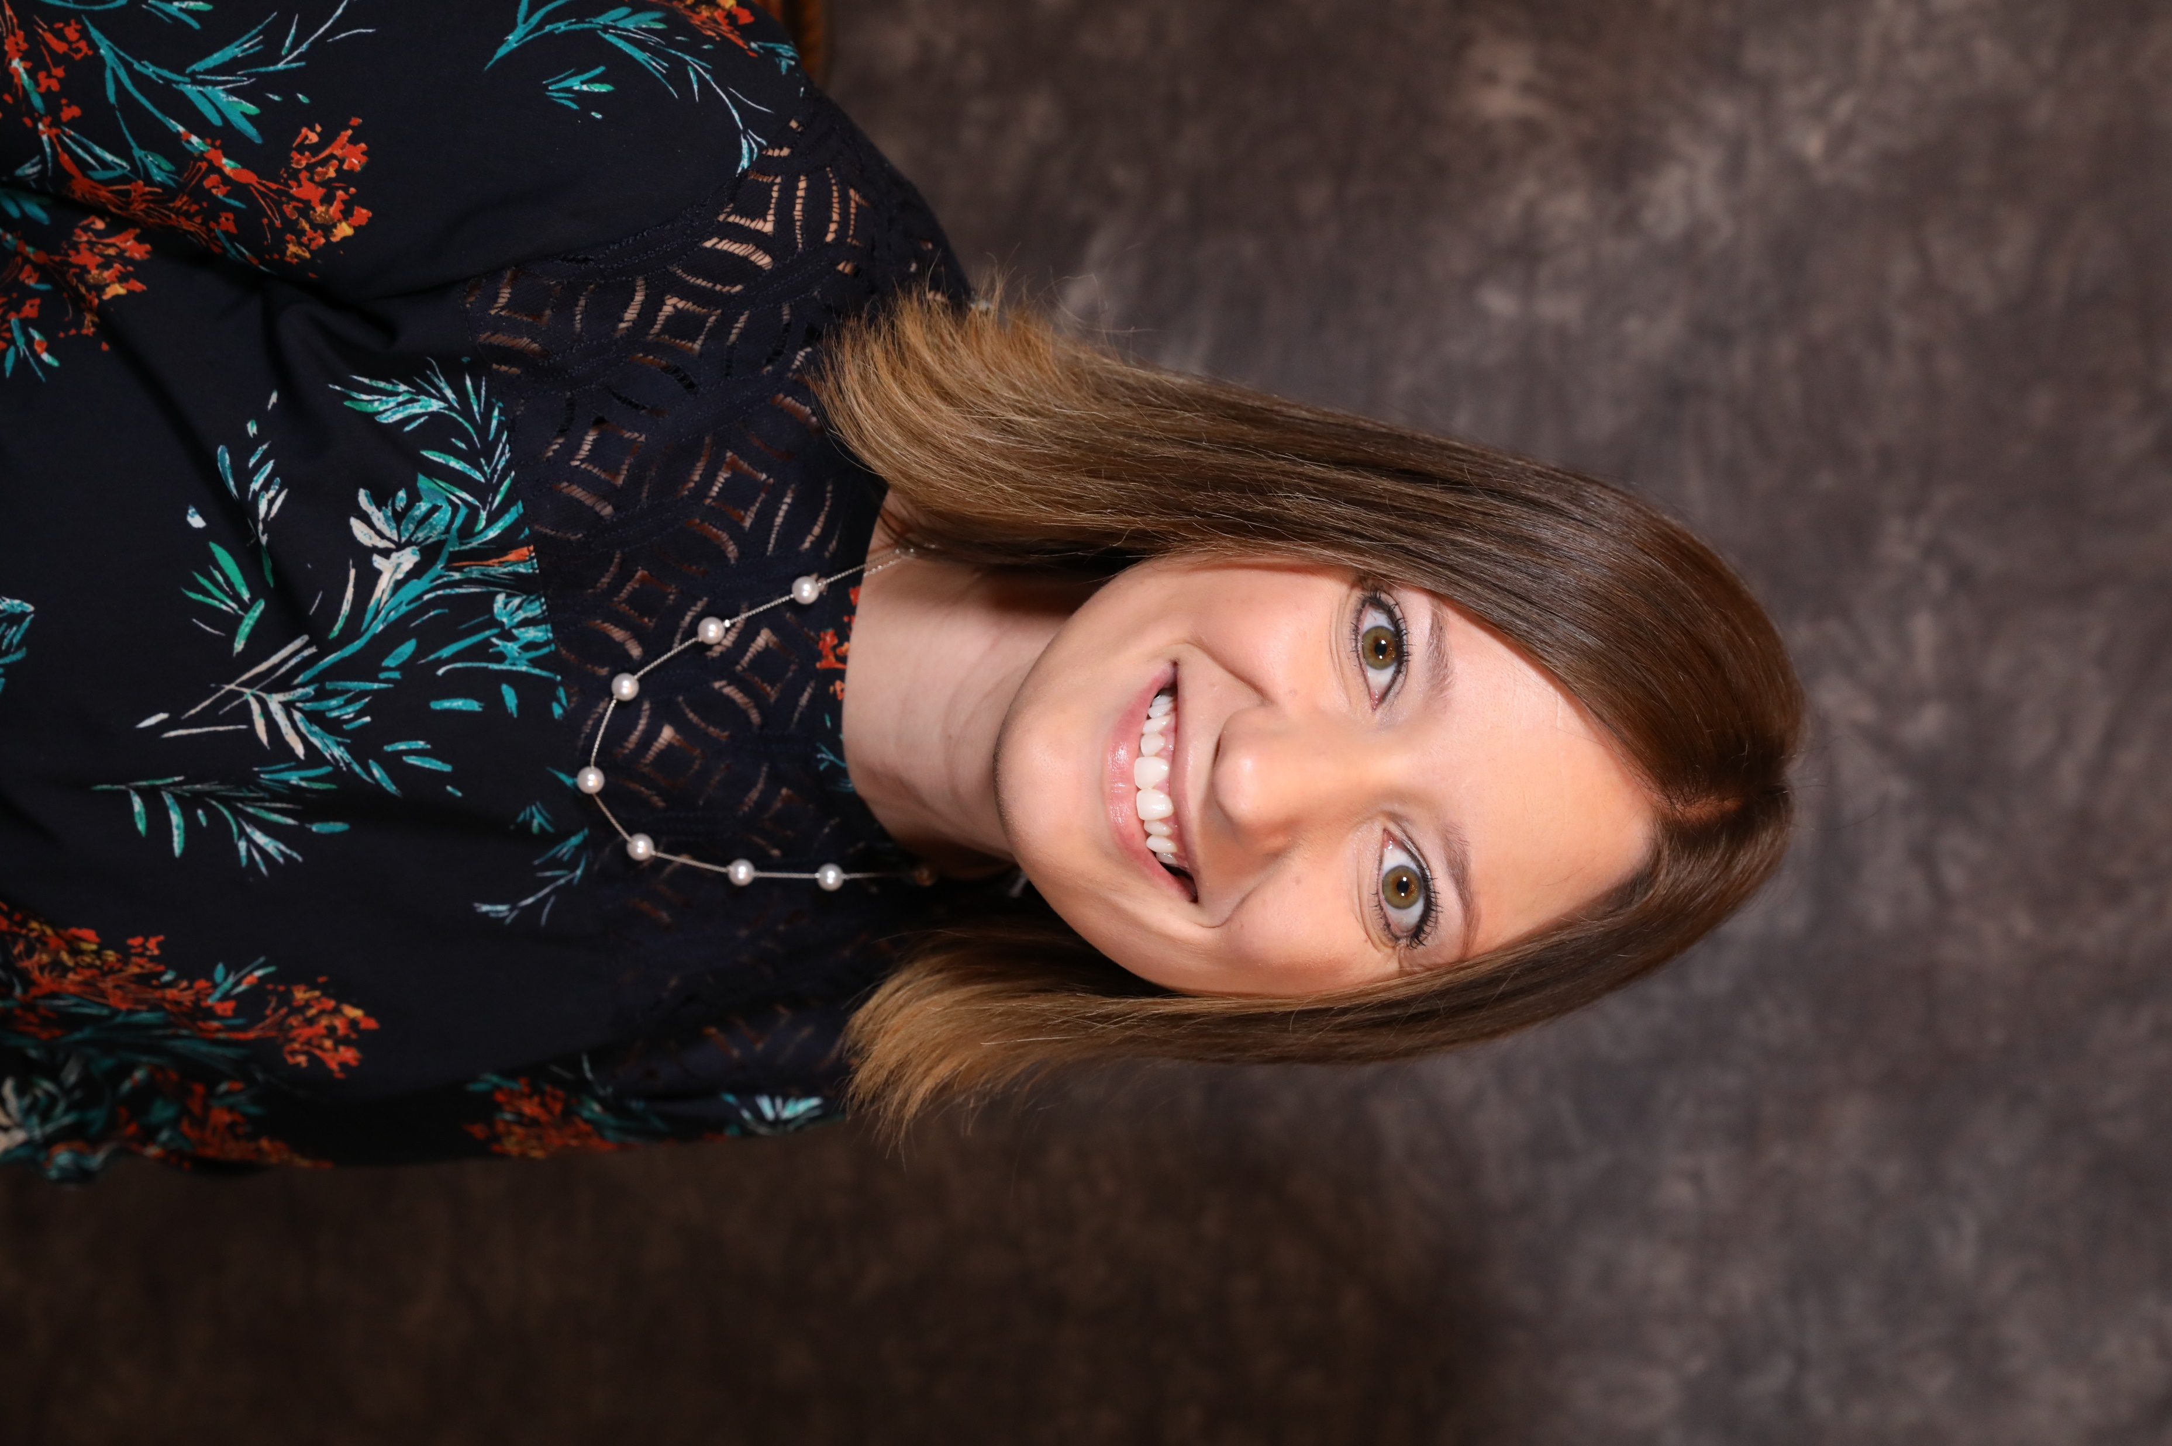
Christopherson Introductions
Adelina Littler
Manager – Implementation & Client Services, Project Manager
Pam Rex
Account Manager, Client Consulting Services

Slide 4
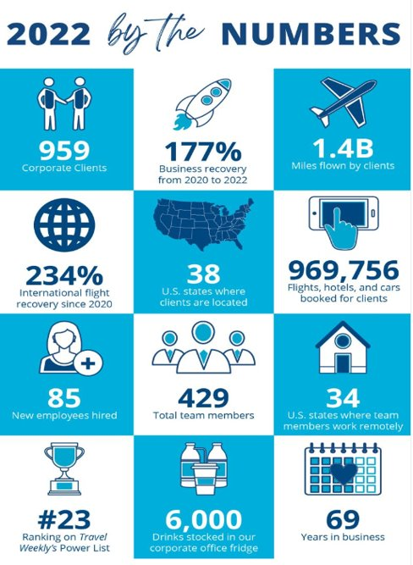
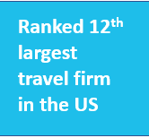
Welcome to Christopherson
Individual, Group, Athletics
Concur Online Booking Tool or 24/7 Skilled Travel Advisors
Improves traveler experience, increases policy compliance, 24/7 real time reporting and itinerary access, and risk management tools
Data Security & Privacy

Slide 5

University of Akron/IUC vendor programs
AIR:
United Airlines discount program through IUC
CAR:
National, Enterprise, Hertz contract discounts
HOTEL:
BCD Travel discounts on 40K+ hotels through Christopherson
Thor consortium discounts available through Christopherson
Conference hotel discounts are not available to book through Christopherson, book directly with conference hotel
CHARTERS:
STM Driven partnership through Christopherson
PERSONAL FREQUENT TRAVELER PROGRAMS CAN BE ADDED TO YOUR PROFILE. PER THE OHIO ETHICS COMMISSION, THE BENEFITS GAINED NEED TO BE USED FOR UNIVERSITY TRAVEL.

Slide 6
Group Travel Needs
EVENTS = Usually 10 or more travelers, not traveling together, but traveling to a common destination to attend a meeting, conference, or occasion.
Complete the Event intake form and email to university.travel@cbtravel.com
An Advisor will respond with instructions to provide the attendees prior to them booking.
Attendees book their own travel by contacting an advisor via phone or email (as noted in the individual travel above) and they follow the instructions on how to identify themselves with the particular event.
GROUP = 10 or more travelers on the same flights, to and from the same destinations for the same event or occasion.
Complete the University Group form and email to universitygroups@cbtravel.com
Often there is a single group coordinator who collaborates with the Advisor.
Usually, the individuals do not manage their own arrangements.
NOT SURE IF IT’S AN EVENT OR A GROUP?
If unsure whether your travel falls more under the event vs. the group parameters, contact one of the priority advisors above. They will qualify and connect you with the correct support team.

Slide 7
Important Contacts
For technical support, contact onlinesupport@cbtravel.com.
To submit questions for Q&A or for policy questions, reach out to shelly@uakron.edu.
To register for a travel profile, please reach out to pcard@uakron.edu.
If you arrange traveler for others and need to be set as a delegate for someone, email pam.rex@cbtravel.com.
To book travel with an advisor, email university.travel@cbtravel.com.

Slide 8
Getting started
University of Akron has Setup Traveler Profiles Two Ways:
Travelers who currently hold a UA travel card were imported into the Christopherson Business Travel system. Welcome emails to log in to Christopherson’s AirPortal system to access and book travel were sent to this group 5/15/2023.
If you do not receive a welcome email, reach out to pcard@uakron.edu to get an enrollment link and some instructions on how to get it set up.
AirPortal Welcome Emails:
The welcome emails that are generated from AirPortal have a live link to create a password that expires in 24 hours.

Slide 9

THANK YOU FOR ATTENDING!
Notes:
Main Headline: Adjectives or descriptors in Open Sans Bold/Nouns or Verbs in Open Sans Light, size 36, white
Sub Headline: Open Sans Light, size 14 pt, white

